Slide 1
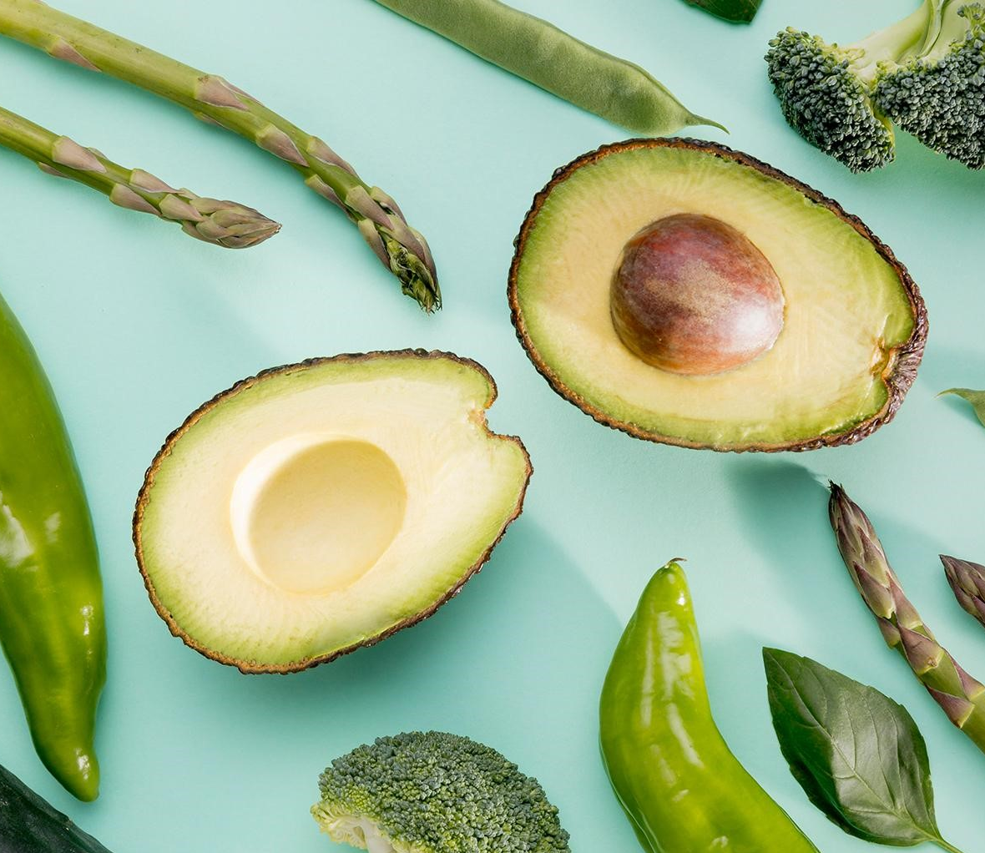
AVOCADO RETAILING TEAM MEMBERS: GOWTHAMI SINDHU PRIYA SHREERAKSHA SHIVAKUMAR MUSADDIQA AZEEZ KIRUTHIKA RAMADOSS

Slide 2

INTRODUCTION

Slide 3
WHY WE CHOSE THIS TOPIC?
Growing Market:
Avocado consumption is rising globally, driven by its health benefits and versatility in diets.
Rising avocado consumption offers an opportunity to study retail trends in this expanding market.
Price Fluctuations:
Prices fluctuate due to factors like supply chain issues, weather, and demand.
Price volatility presents an interesting challenge for forecasting market behavior.
Consumer Insights:
Consumers in different regions have different preferences. The dataset reveals regional preferences and consumer behavior.
Data Availability:
The dataset offers detailed information on various avocado varieties across regions, providing a comprehensive market view.

Slide 4
DATASET
The dataset we have considered for the retail analysis of the avocado market is found at: https://www.kaggle.com/datasets/mathurinache/avocado-augmented
This dataset contains the following
data variables:
Date Total Bags
AveragePrice Small Bags
Total Volume Large Bags
4046 (small/medium hass avocado) X Large Bags
4225 (large hass avocado) Type
4770 (xlarge hass avocado) Year
Region
For further analysis of the avocado sales, we have selected the product small/medium Hass avocado(4046) in three markets(cities) New York, Seattle and Los Angeles.

Slide 5
DESCRIPTIVE ANALYSIS

Slide 6
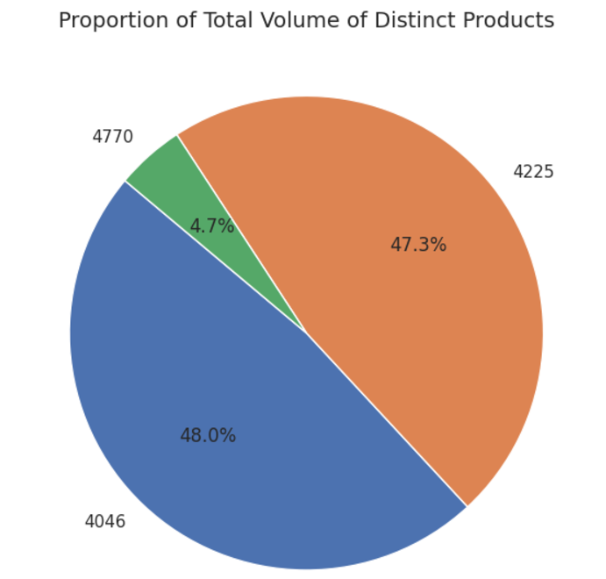
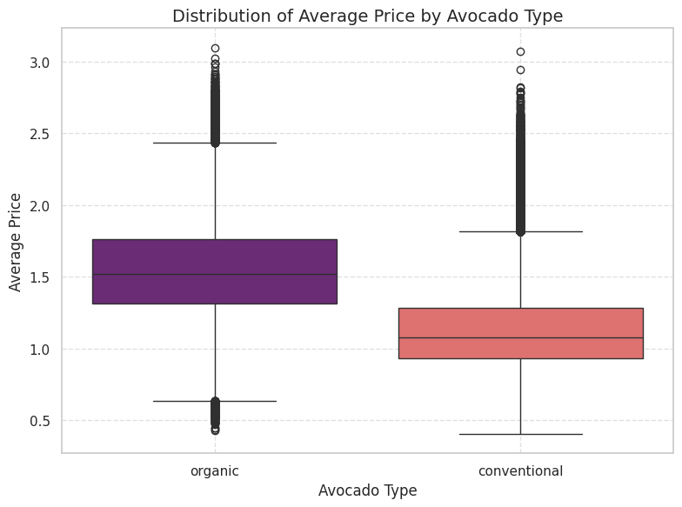
AVOCADO VOLUME AND PRICE BY PRODUCT AND TYPE
Insights: The market is primarily driven by small or medium Hass avocados, followed by large Hass avocados, with extra-large Hass avocados playing a minor role.
Insights: Organic avocados have a significantly higher price compared to conventional avocados.

Slide 7
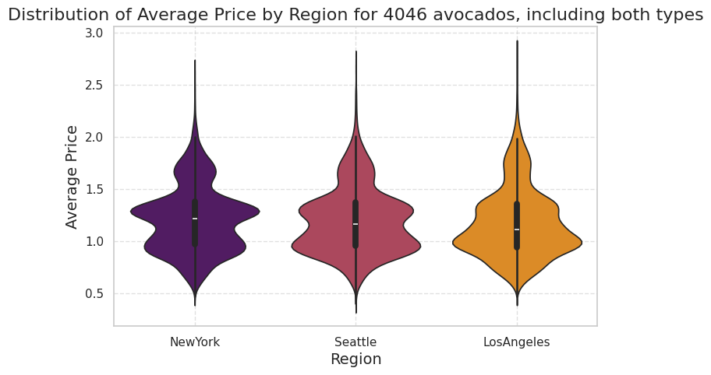
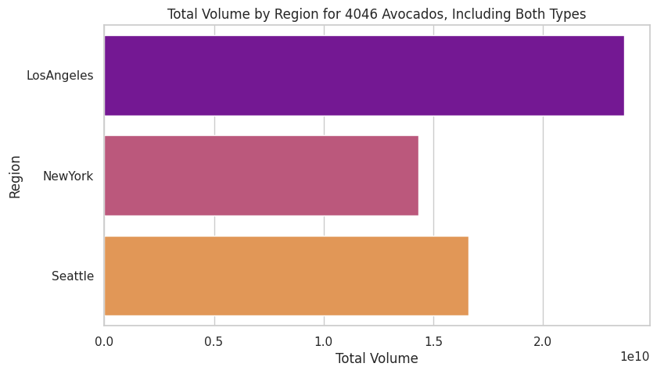
AVOCADO VOLUME AND PRICE BY REGION
Insights: Based on the violin plot, New York has the highest average price for 4046 avocados, followed by Seattle and Los Angeles, highlighting regional price differences.
Insights: Los Angeles has the highest total volume of 4046 avocados, followed by Seattle with New York having the lowest volume, indicating smaller market demand.

Slide 8
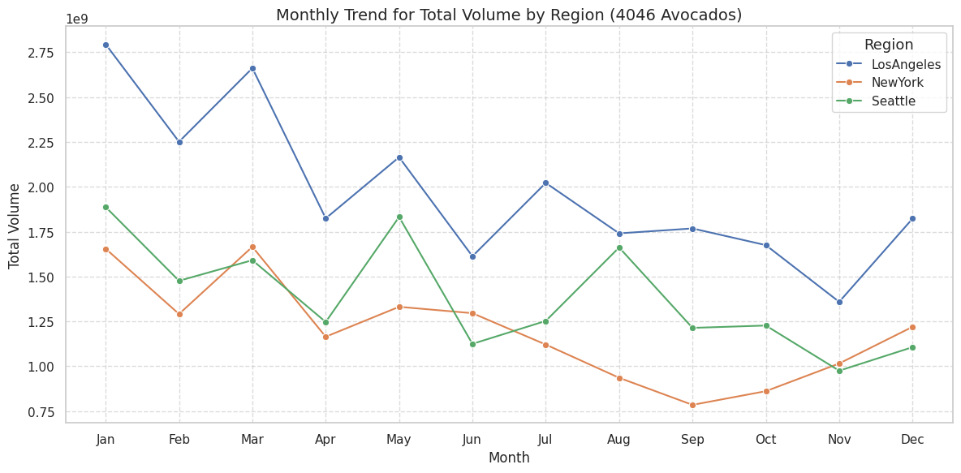
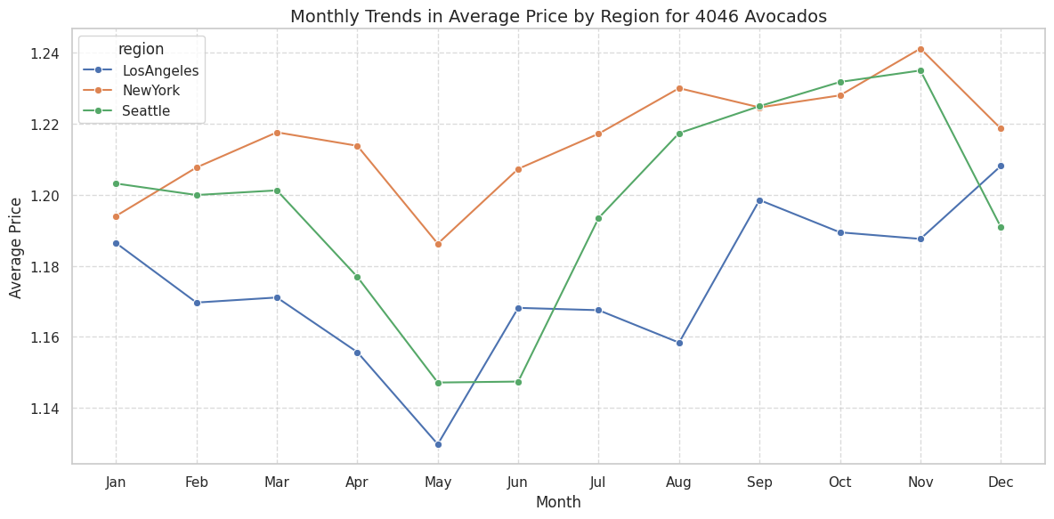
AVOCADO VOLUME AND PRICE MONTHLY TRENDS BY REGION
Insights: The total volume sold peaks in warmer months and drops in colder months, while prices show the opposite trend, peaking in colder months. Los Angeles leads in total volume, Seattle lags, and New York has the highest prices.

Slide 9
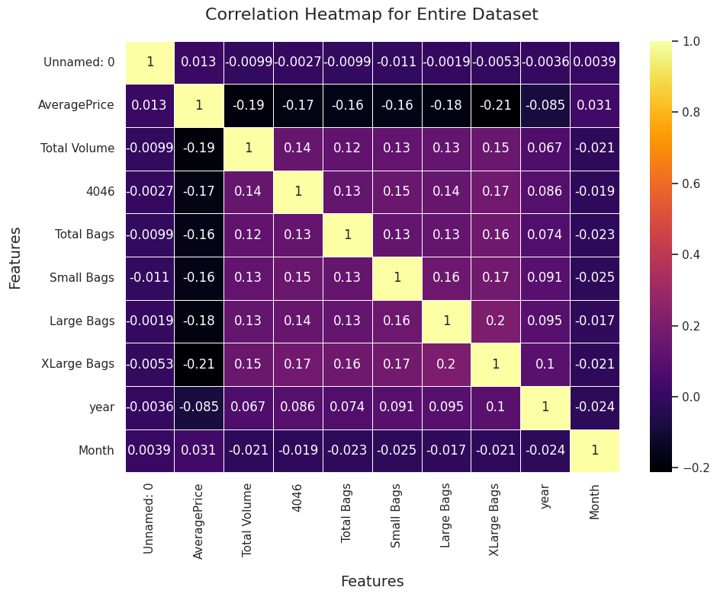
CORRELATION ANALYSIS
Insights: The heatmap highlights that Total Volume and 4046 avocados, show the strongest positive correlation, while bag size and price have the strongest negative correlation, indicating larger bags tend to have lower prices.

Slide 10
PREDICTIVE ANALYSIS

Slide 11
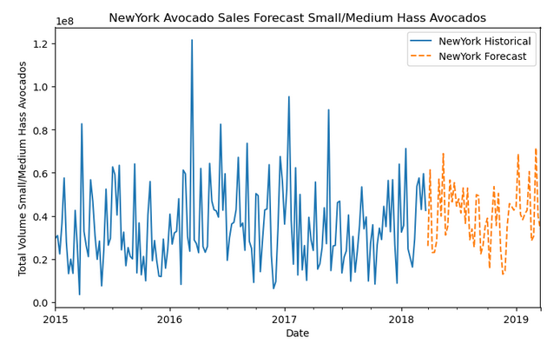
SMALL/MEDIUM HASS AVOCADO SALES FORECAST
Forecast of small/medium Hass avocado sales for the next year in New York:
Insights:
There is volatility in avocado sales, with sharp spikes and dips.
There are seasonal fluctuations in avocado sales, with peaks in the summer months and troughs in the winter.
The forecast data shows a moderate upward trend in avocado sales, indicating moderate demand.

Slide 12
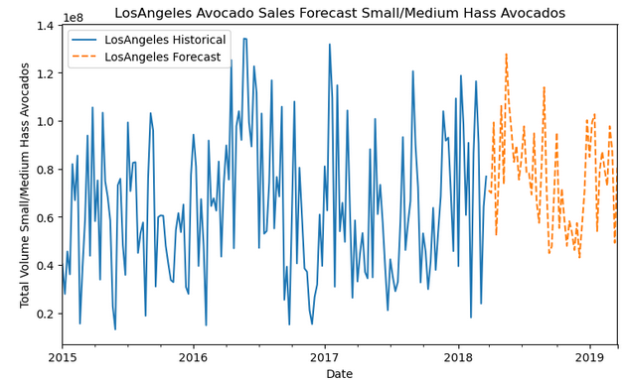
SMALL/MEDIUM HASS AVOCADO SALES FORECAST
Forecast of small/medium Hass avocado sales for the next year in Los Angeles:
Insights:
The avocado sales in Los Angeles have a volatile profile.
The most dramatic seasonal fluctuations in avocado sales, with sharp spikes during summer months.
The forecast data shows a strong upward trend in avocado sales, suggesting a significant demand potential in the region.

Slide 13
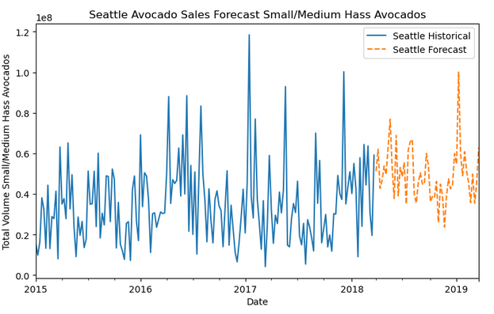
SMALL/MEDIUM HASS AVOCADO SALES FORECAST
Forecast of small/medium Hass avocado sales for the next year in Seattle:
Insights:
The avocado sales in Seattle have a slightly less volatile profile compared to the other two markets, which indicates a stable demand.
There are seasonal fluctuations in avocado sales, with peaks in the summer months and early fall periods.
The forecast data shows an upward trend in avocado sales, suggesting a growing demand.

Slide 14
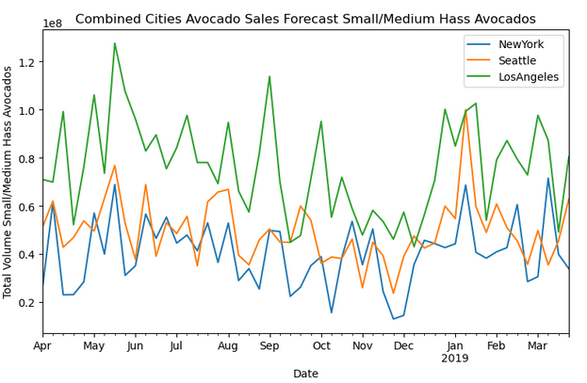
SMALL/MEDIUM HASS AVOCADO SALES FORECAST
Insights:
Sales volume is the highest in Los Angeles compared to New York and Seattle for small/medium Hass avocados.
All three markets exhibit seasonal fluctuations with small/medium Hass avocado sales peaking during the summer months.
Recommendations:
Focus on demand forecasting.
Include selection of small/medium Hass avocado products like pre-made, ready to eat options.
Target local market preferences.
Develop e-commerce capabilities.

Slide 15
PRESCRIPTIVE ANALYSIS

Slide 16
INTRODUCTION
Objective: Determine the optimal supplier for each market (domestic, imported, or combined).
Approach: Used optimization modeling to minimize costs while meeting demand.
Data Collection: Data is collected from trusted USDA market news portal https://www.marketnews.usda.gov/mnp/fv-report-retail?repType=&run=&portal=fv&locChoose=&commodityClass=&startIndex=1&type=retail&class=FRUITS&commodity=AVOCADOS&region=ALL&organic=ALL&repDate=01%2F01%2F2023&endDate=11%2F27%2F2024&compareLy=No

Slide 17
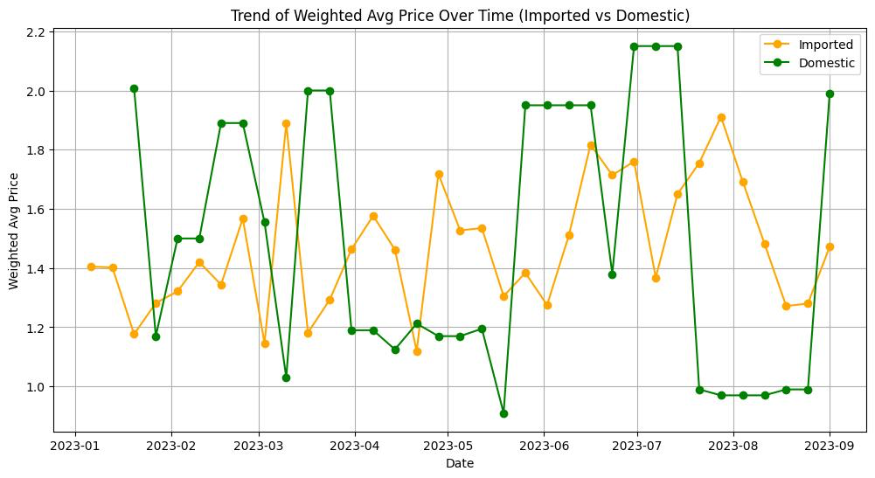
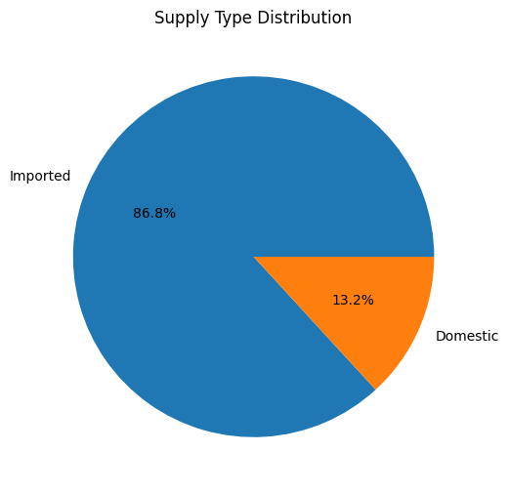
DATA VISUALIZATION
Insights: The updated chart shows that 86.8% of avocado supplies are imported, while 13.2% are domestic. This reflects the industry reality, where the majority of avocados in the U.S. are sourced internationally.
Insights: Domestic avocado prices are highly volatile with frequent spikes, while imported avocados maintain more stable and lower prices, highlighting their cost advantage. Seasonal trends and occasional gaps in domestic supply suggest the need for improved local supply chain stability and planning.

Slide 18
OPTIMIZATION METHODOLOGY
Objective: Minimize total supply costs.
Decision Variables: Proportions of domestic and imported supply.
Constraints:
Meet regional demand.
Maintain 90% imported and 10% domestic supply.
Tools: Linear programming model using Python.

Slide 19
OPTIMIZATION RESULTS
Insights:
Midwest uses a mix of domestic and imported supply.
Northeast and Southeast rely entirely on imports.
Region | Domestic (%) | Imported (%)
Midwest U.S. | 10% | 90%
Northeast U.S. | 0% | 100%
Southeast U.S | 0% | 100%

Slide 20
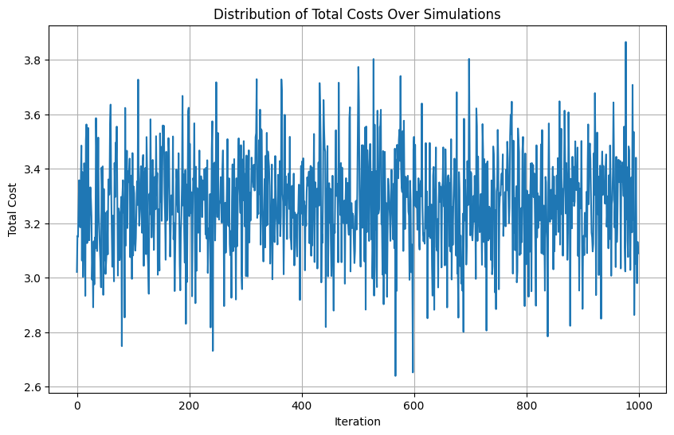
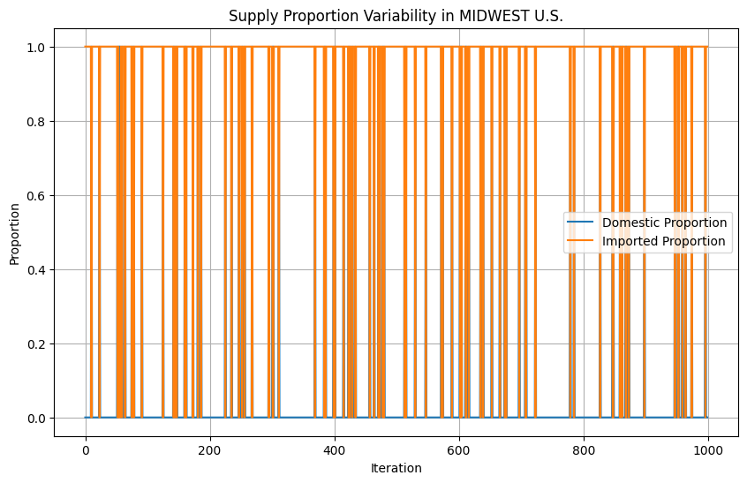
SIMULATION
The model strongly favors imported supply due to its consistent cost advantage, with minimal shifts in supply proportions even under cost fluctuations, making domestic supply viable only with significant cost reductions.

Slide 21
INSIGHTS AND RECOMMENDATIONS
Insights:
Imported supply dominates due to cost advantages.
Domestic supply plays a minimal role unless costs are reduced.
Total costs are moderately sensitive to fluctuations.
Recommendations:
Focus on imported supply for cost efficiency.
Invest in reducing domestic production costs.
Conduct regular scenario analysis to adapt to market changes.

Slide 22
CONCLUSION

Slide 23
SUMMARY
Analysis of the small/medium Hass avocado sales volume and prices in New York, Seattle and Los Angeles markets gives insights into the market preferences, seasonality fluctuations and demand potential.
Forecasting the sales for the next year in these three markets provides insights to avocado retailers to adapt to market-specific preferences, make smart inventory and supply decisions and drive sustainable growth in these markets.
Data collection favored the import of avocados as it is more cost-effective and indicated there is potential to increase local supply if costs can be lowered.

Slide 24

THANK YOU

